Slide 1


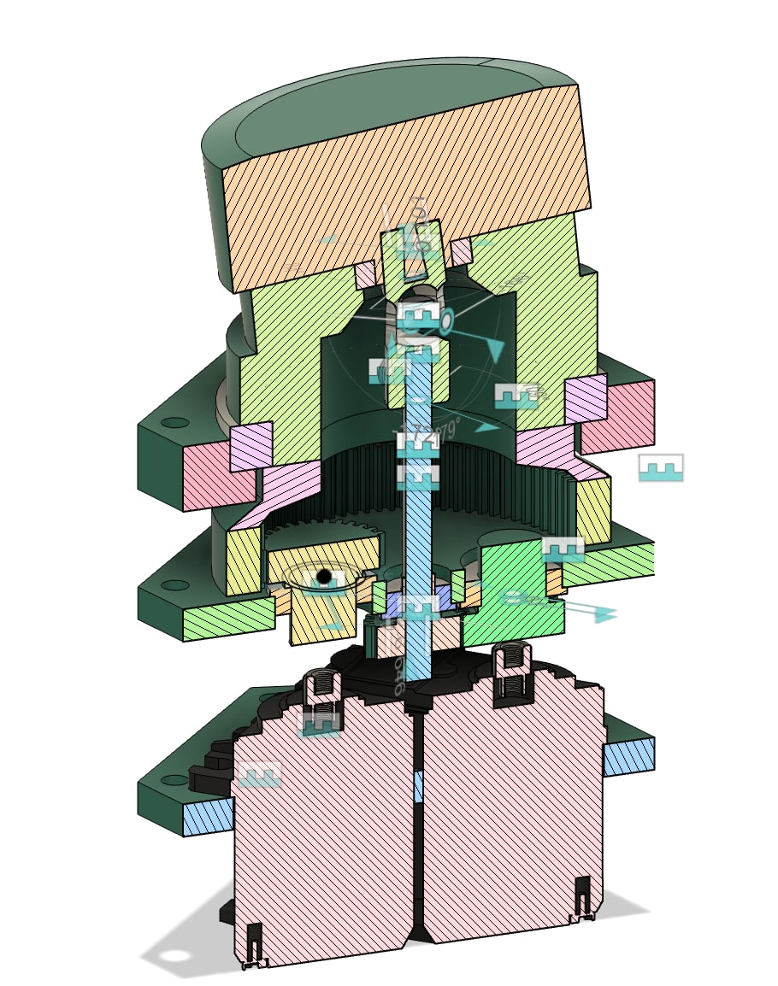
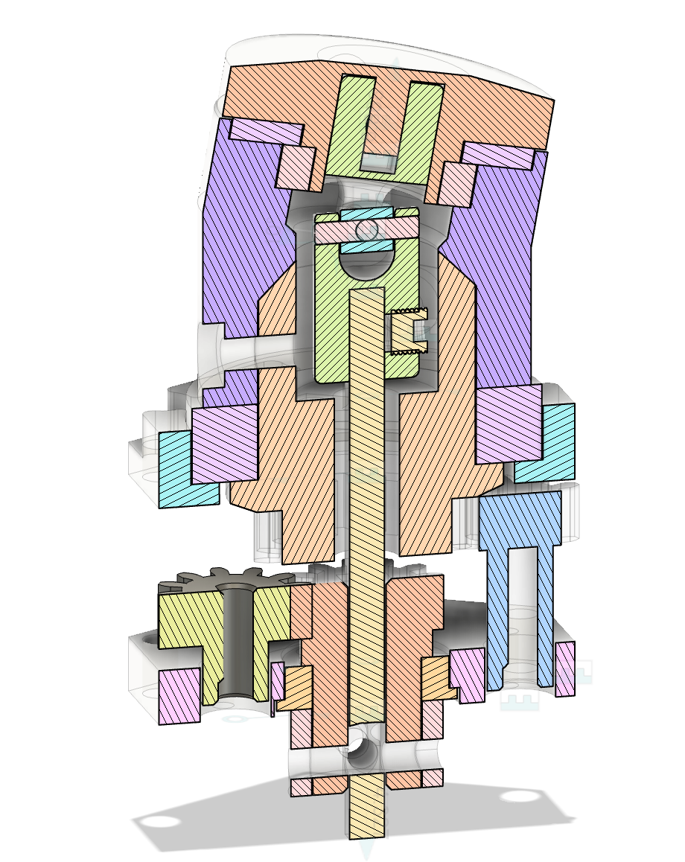
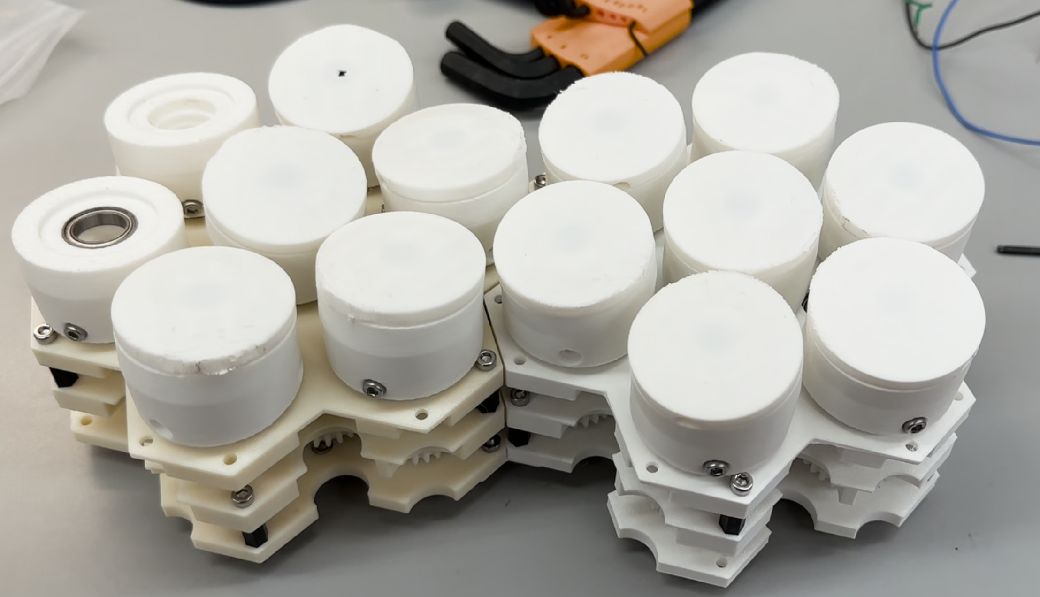
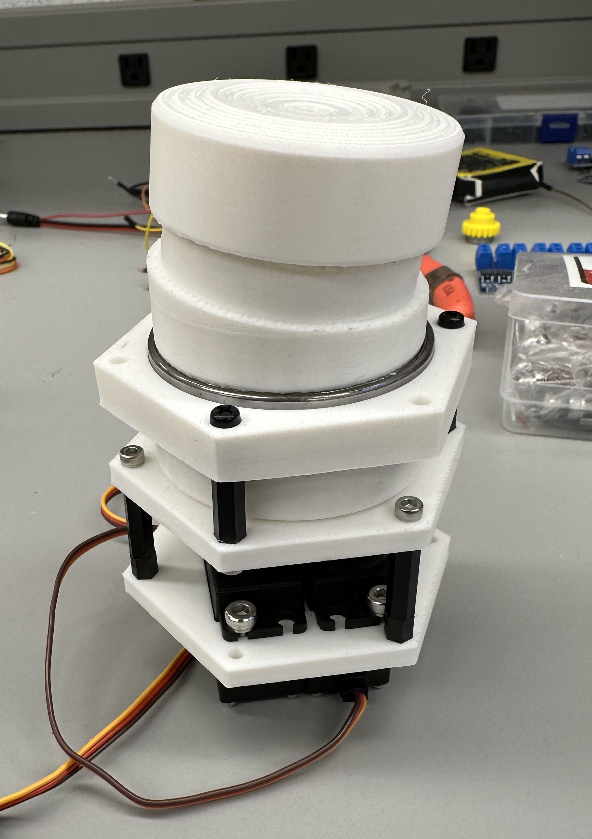
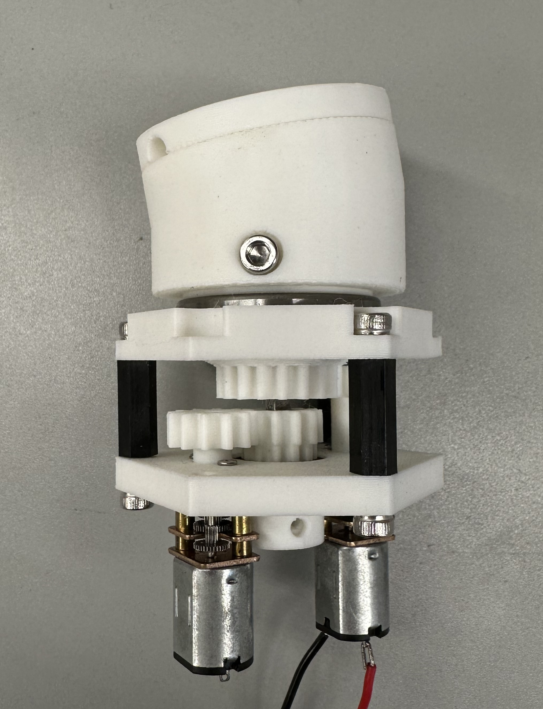
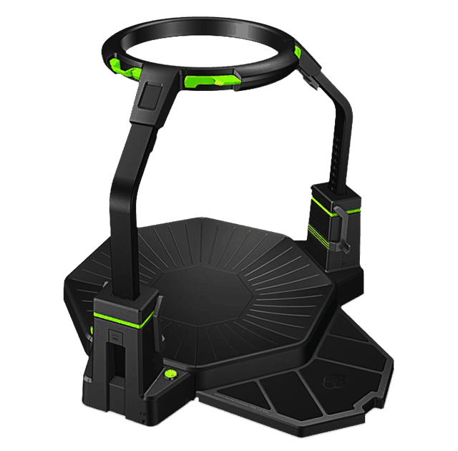
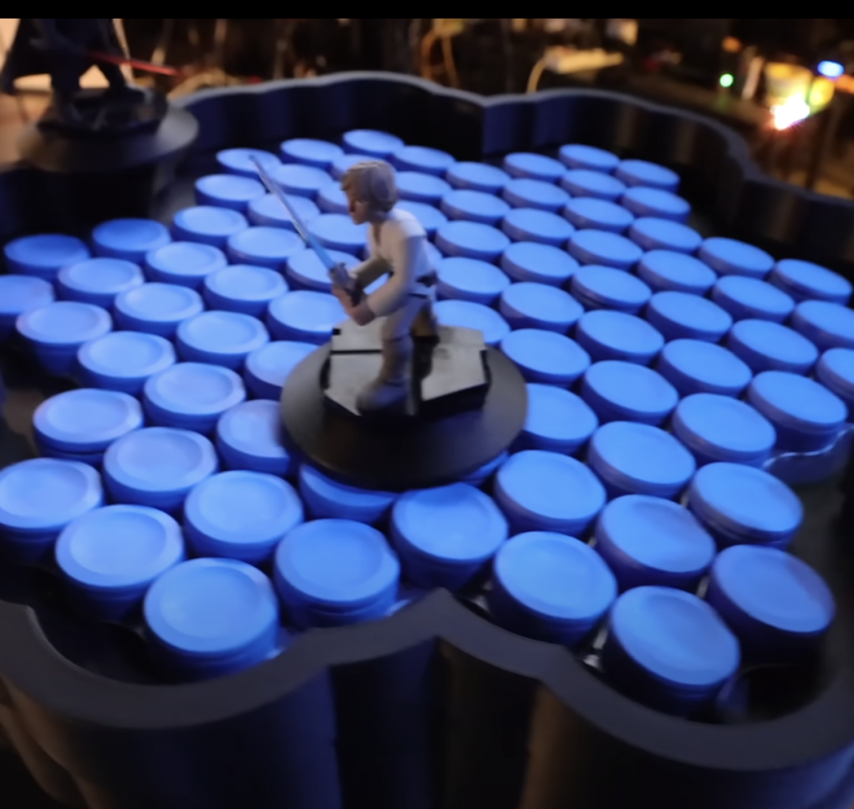
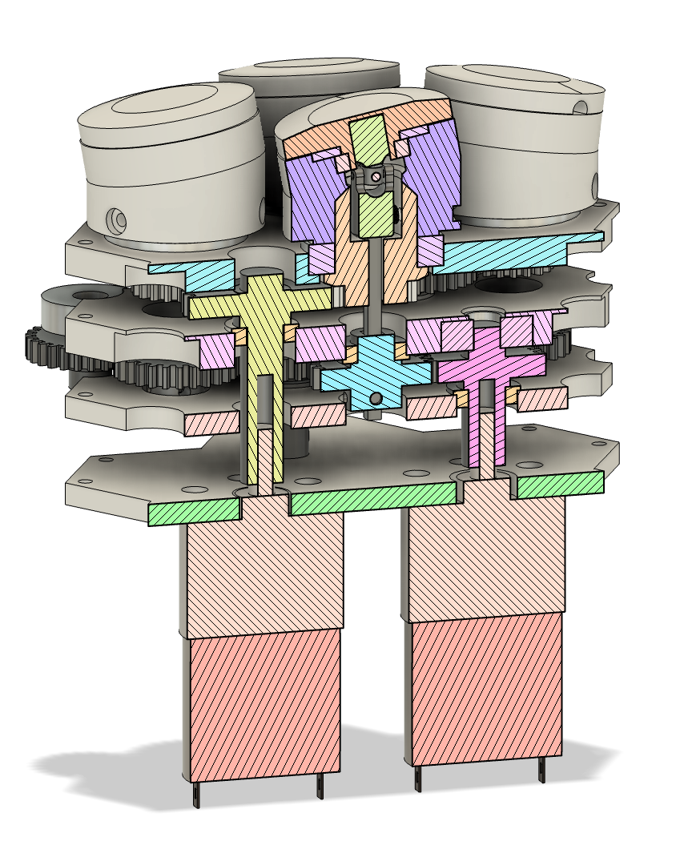
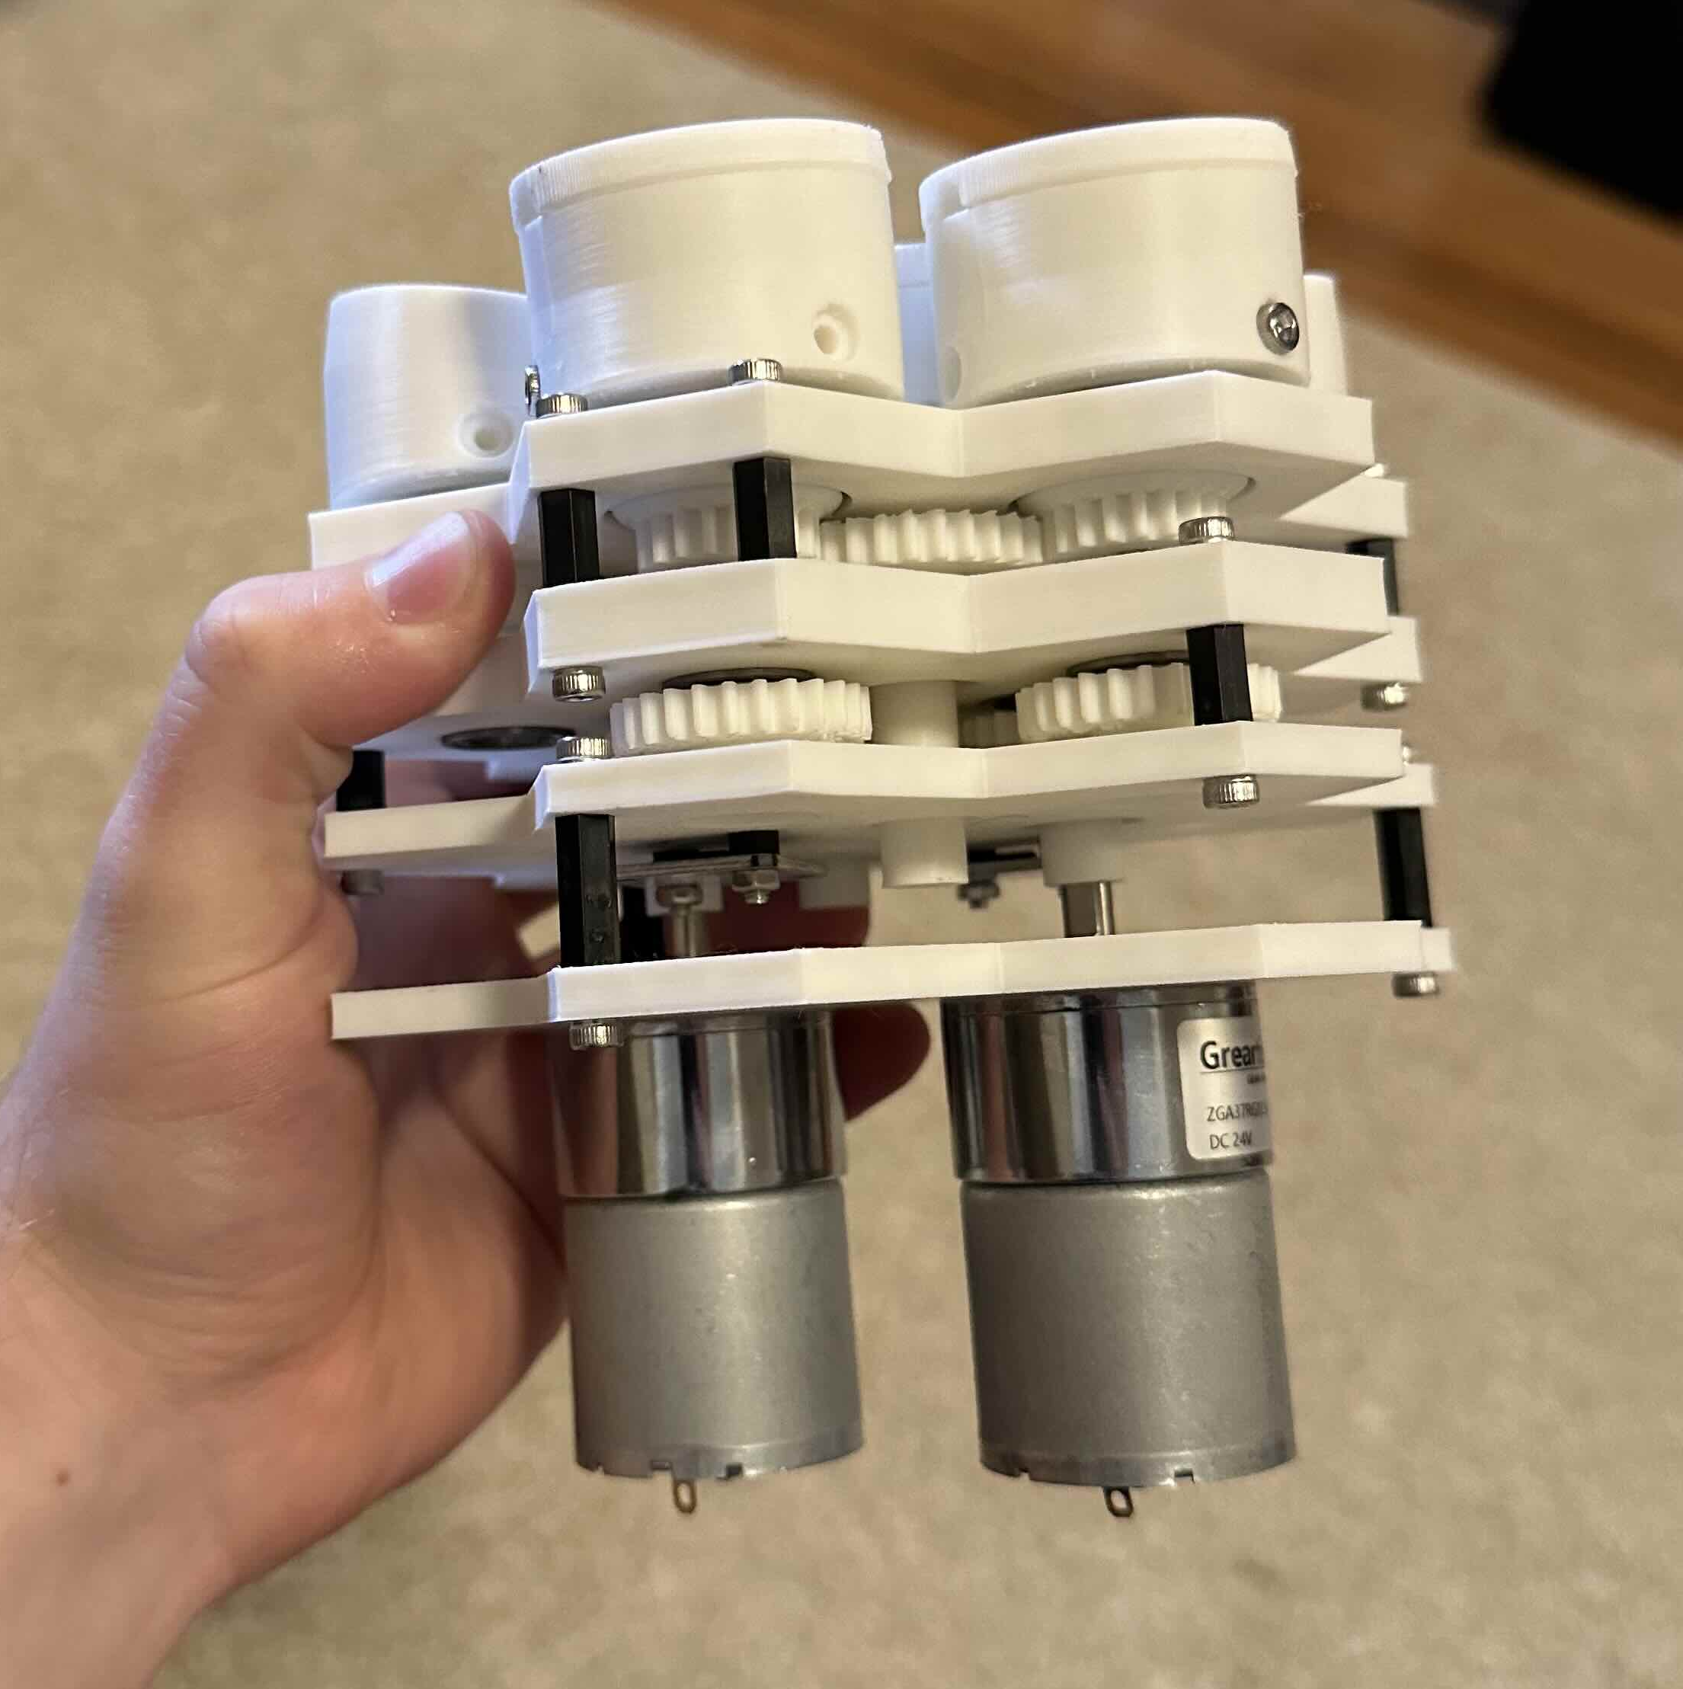

Omnidirectional Treadmill
ECE 497
Senior Independent Work
Tim Gubskiy (ECE)
Read about it!
Background and Motivation
Prototypes
Testing and Results
Movement in virtual spaces, accessed through virtual reality headsets, is predominantly decoupled from reality. Aside from a few exceptions, like VR arcades, virtual reality occupies far more space than the room in which you are playing, creating the need for ways to move in VR without moving in real life. When what you see is out of sync with your senses it can cause motion sickness, which is a common complaint from many people when they try VR. Moving in virtual reality without moving in real life can ruin the, reminding you that what you see in front of your eyes is not really there.
The modules are designed such that they can tile together and tie into the gear movements of the previous module. Therefore, one set of motors can control as many modules as needed. I currently have three modules attached together, and it works to manipulate light objects along the surface of the treadmill!
Existing Solutions
Next Steps: Hardware
Going into next semester I will finish expanding the surface area of the treadmill to make it walkable and begin reinforcing it to support the weight of a person. I’ve started this through the use of aluminum back plates. Moving forward, I will focus on making sure that the plastic parts of the treadmill support minimal weight.
Virtuix Treadmill (left), Disney Holotile (right)
Version 1 and 2, CAD and side by side comparison
Design Concept
Final Design: Reducing Cost
Similar to the Disney Holotile design, I will be using cones that are able to change their angle while rotating. The highest edge of the cone will make contact with the foot, and when it rotates it will carry the foot along the top edge.
Next Steps: Software
Once the treadmill is able to support a human, instructing the treadmill through a controller will no longer be responsive enough, and an autonomous solution will be needed. Using cameras to pinpoint the user’s location, the treadmill will automatically move the user back to the center, allowing them to use it without any external input.
Holotile visualization from MKBHD video
Tiled Design greatly reduces the number of motors in the design, heavily reducing the cost

